Slide 1
Physiological signal introduction and processing
Dr Zhiqiang Zhang
School of Electronic and Electrical Engineering
School of Mechanical Engineering
Faculty of Engineering and Physical Sciences
Email: z.zhang3@leeds.ac.uk
Room: EEE 1.69

Slide 2
Action potential
Notes:
The action potential includes a depolarization (activation) followed by a repolarization (recovery). The action potential occurs in all cardiac cells but its appearance varies depending on cell type. During de- and repolarization ions (Na+ [sodium], K+ [potassium] and Ca2+ [calcium]) flows back and forth across the cell membrane. Because ions are electrically charged, their movement generates an electrical current. This means that propagation (spread) of the action potential is equal to spread of an electrical current.

Slide 3

Discussion
Are there any difference among different action potentials??

Slide 4
Action potential
Notes:
The cells that initiate action potentials are called ‘excitable cells’. Action potentials can have different shapes; i.e. different amplitudes and durations
Thus, the amplitude, duration, and shape of the action potential are determined largely by the properties of the excitable membrane。。。Such as ionic concentrations, membrane capacitance,
One major difference is in the duration of the action potentials. In a typical nerve, the action potential duration is about 1 ms. In skeletal muscle cells, the action potential duration is approximately 2-5 ms. In contrast, the duration of cardiac action potentials ranges from 200 to 400 ms.

Slide 5
Excitable cells are the sources of bioelectric potentials
electrochemical activity of a certain class of cells
components of nervous, muscular, & glandular tissue
Recordings of bioelectric phenomena
electrocardiogram (ECG)
electroencephalogram (EEG)
electromyogram (EMG)
Notes:
Ask what other E*G, ENG, EoG

Slide 6
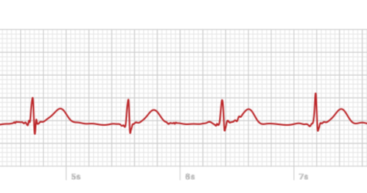
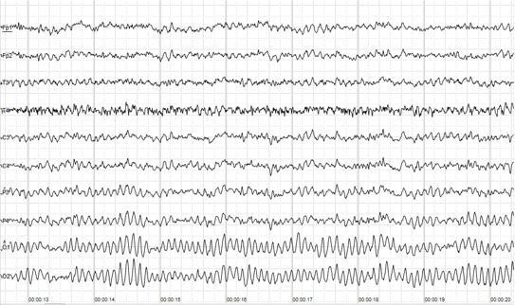
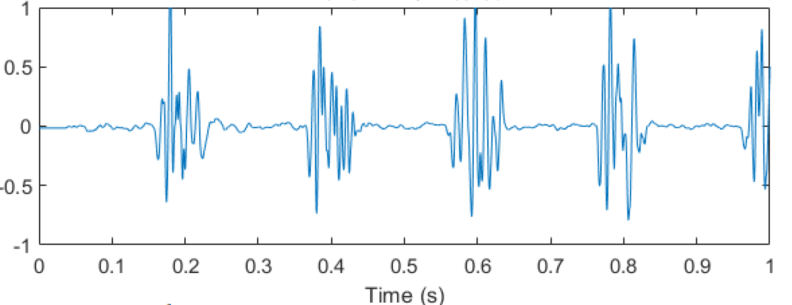
Typical physiological signals
Notes:
Which one is which one???

Slide 7
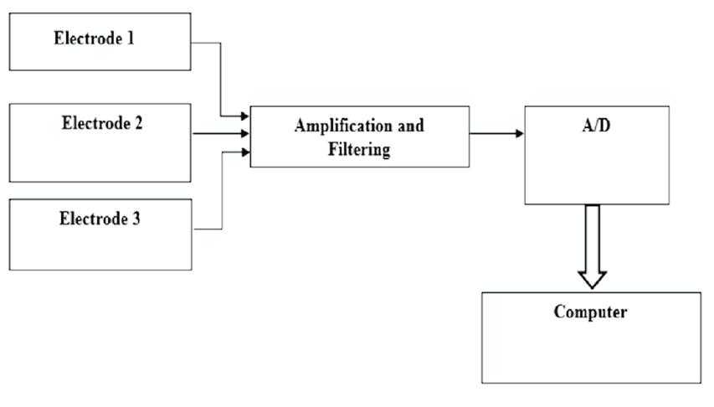
Physiological signals acquisition

Slide 8
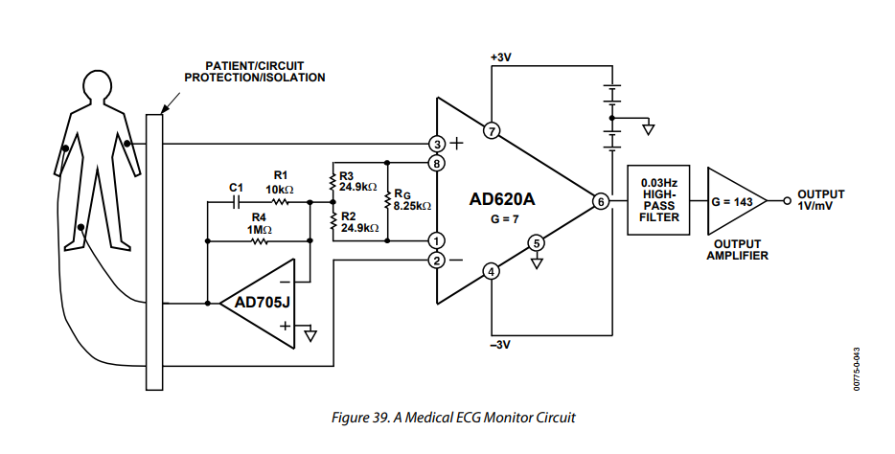
Differential amplification: ECG

Slide 9
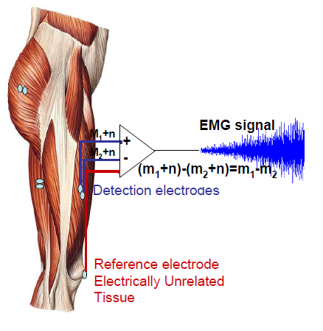
Differential amplification:EMG
Input from two different points of the muscle (usually 1-2cm)
Subtracts the two inputs
Amplifies the difference
EMG signal consist of
Muscle activity (m)
Electric noise (n)

Slide 10
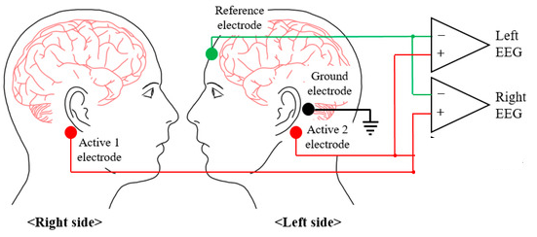
Differential amplification: EEG

Slide 11
Discussion
Assuming we have some device for ECG acquisition, can this device be used for EEG/EMG data collection??

Slide 12
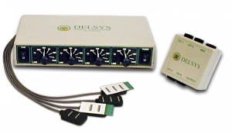
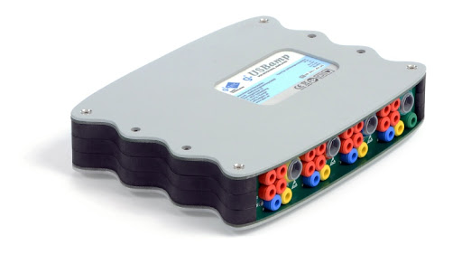
Amplifier and ADC convertor
Commercially available

Slide 13
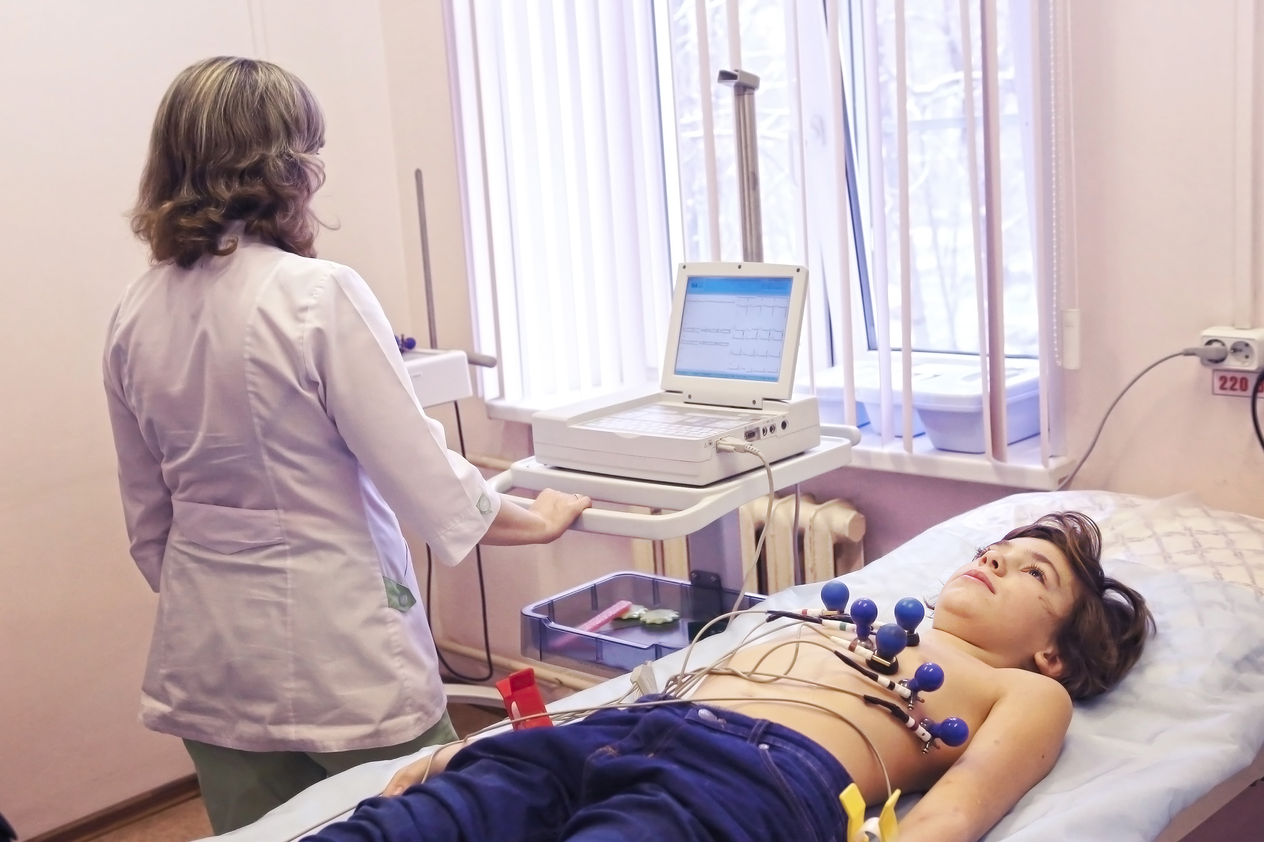
Traditional setup

Slide 14
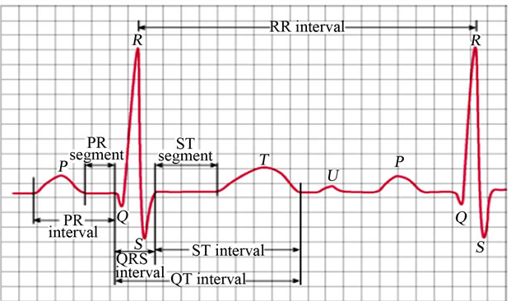

Slide 15
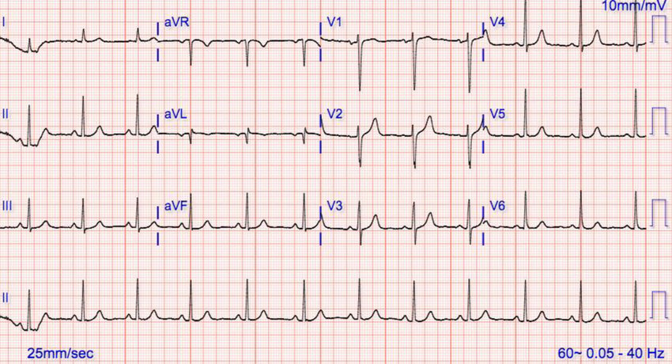
Is this normal?

Slide 16
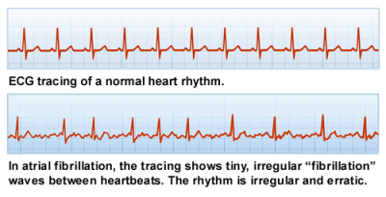

Slide 17
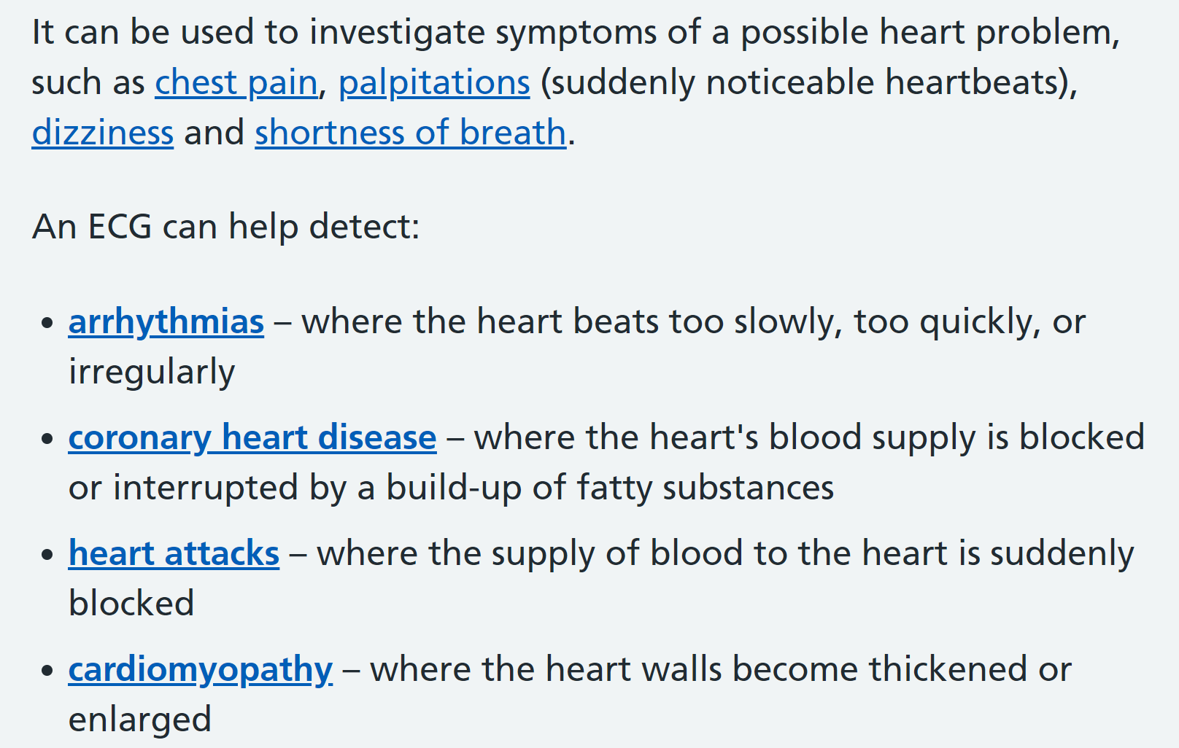
Applications: ECG
https://www.nhs.uk/conditions/electrocardiogram

Slide 18
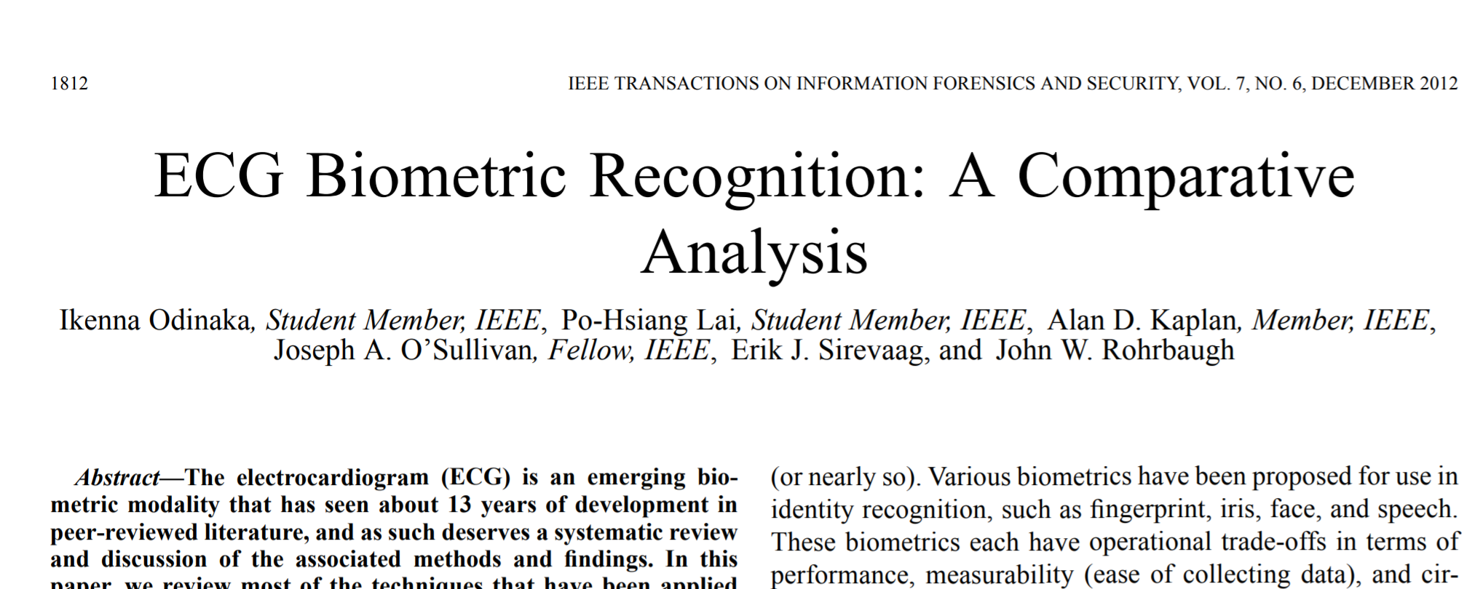
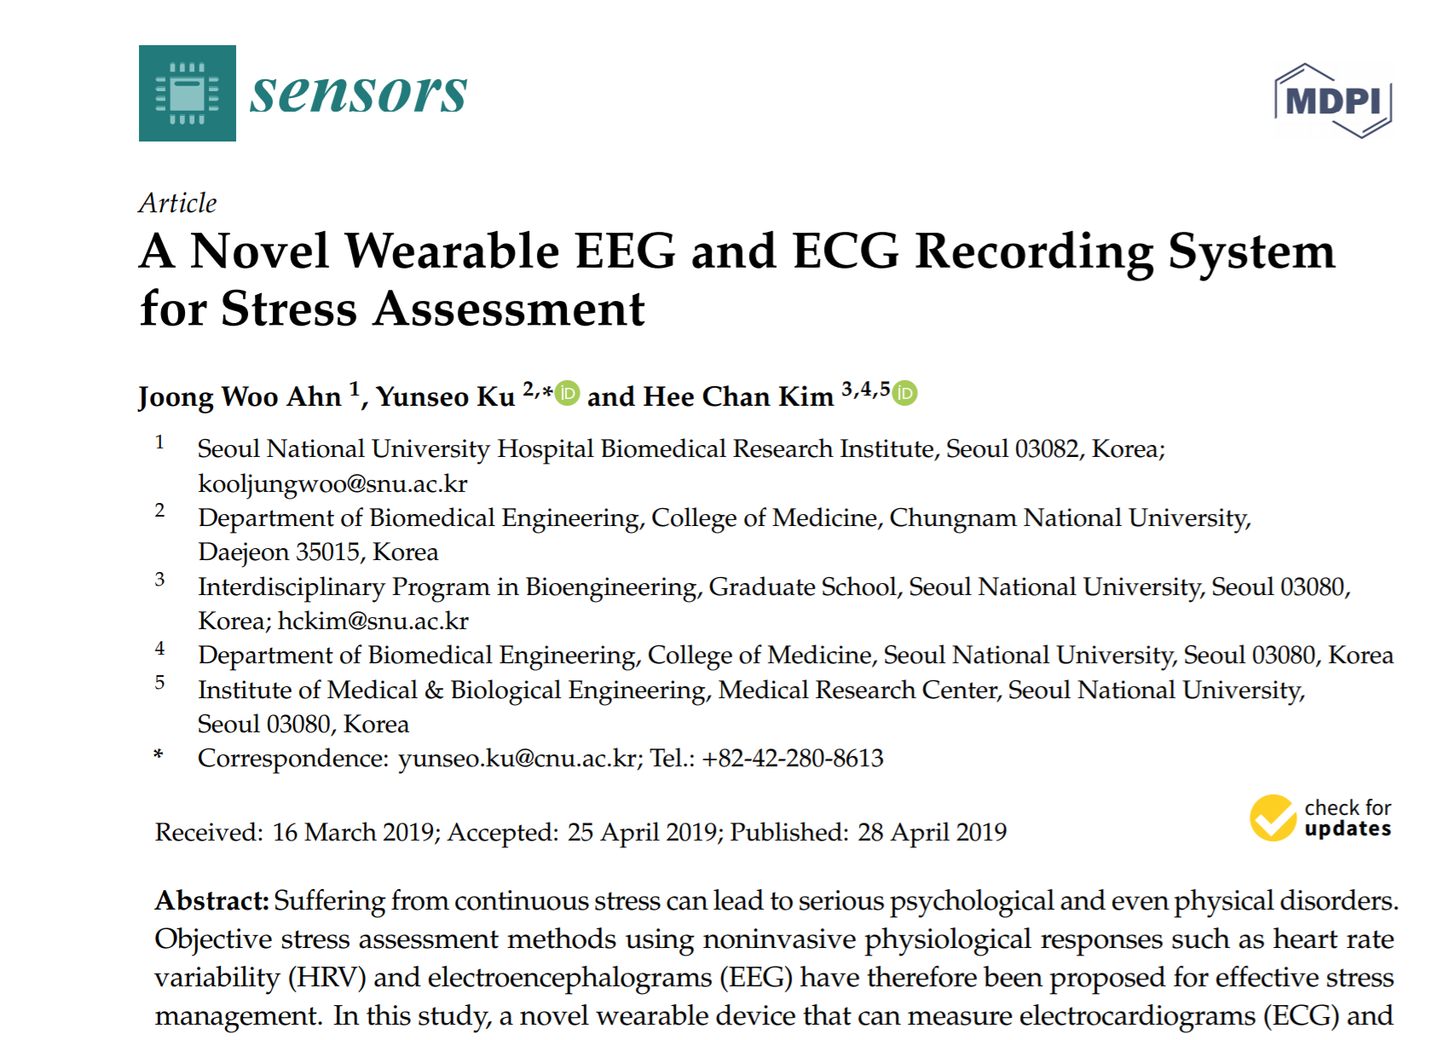
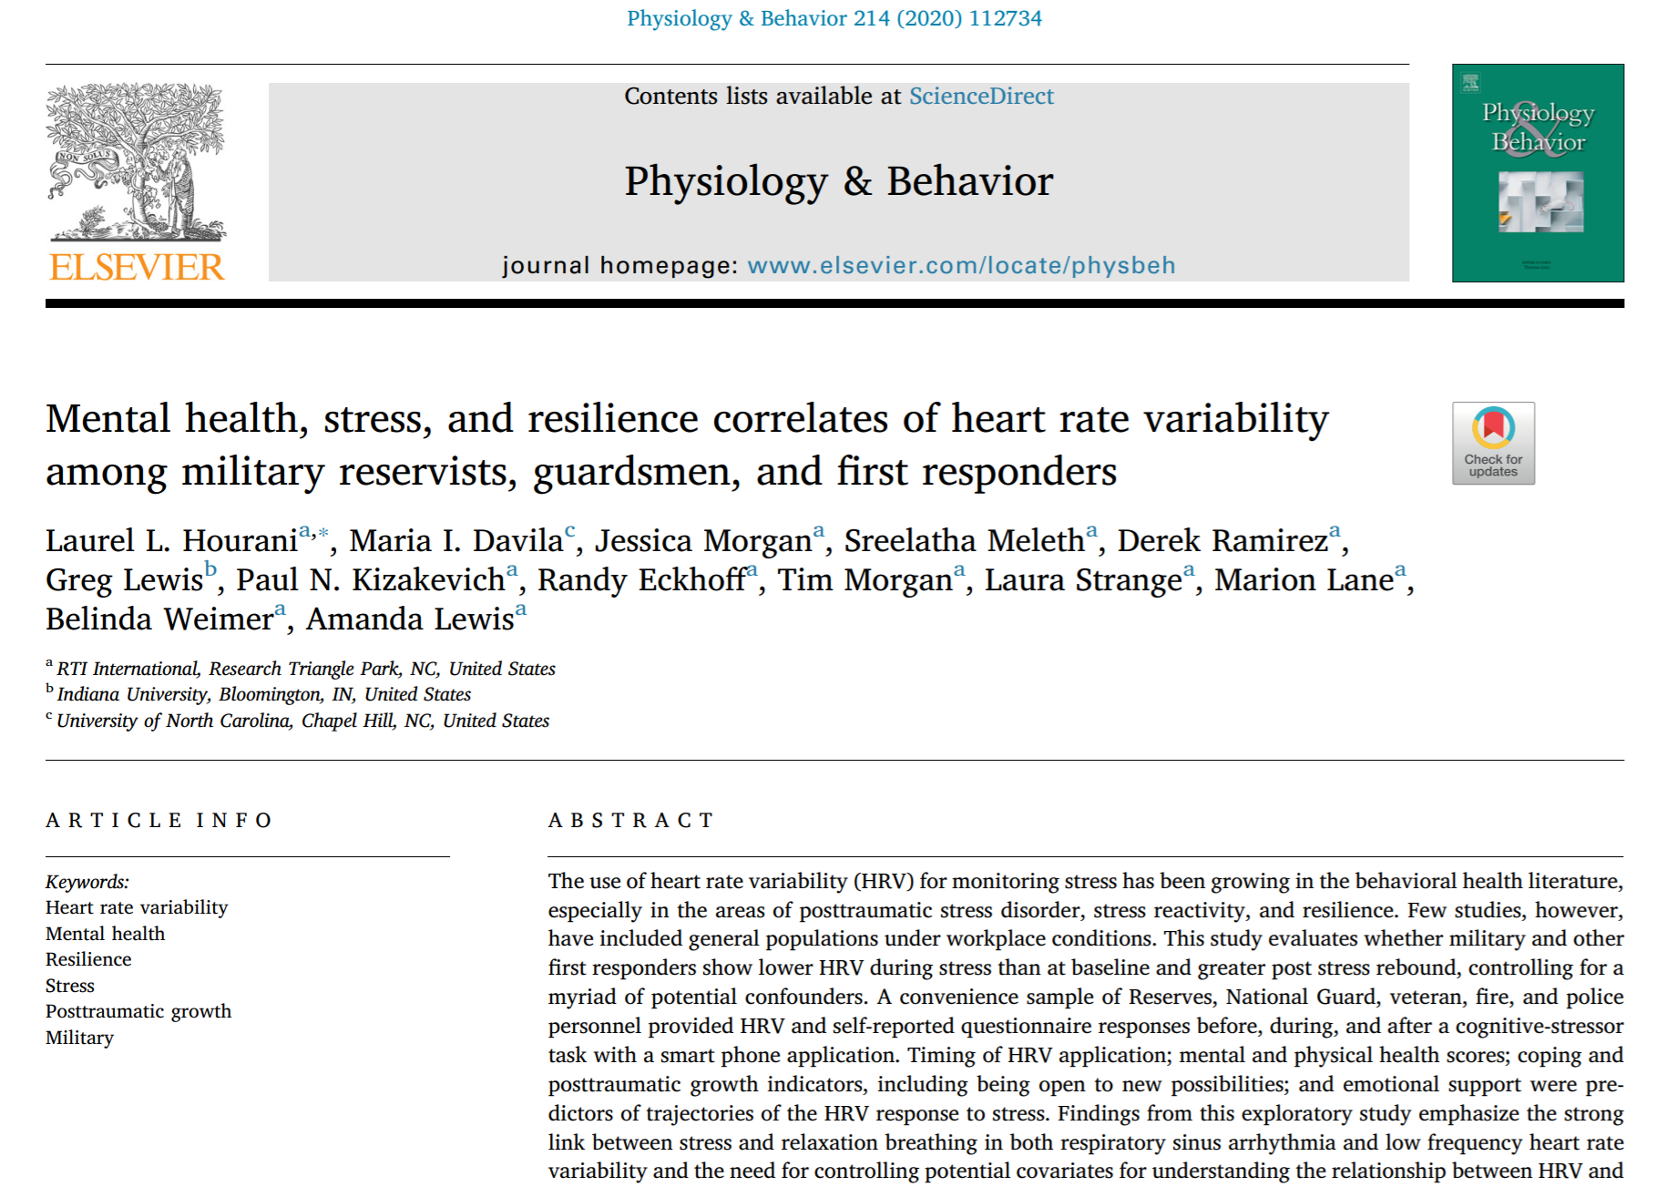
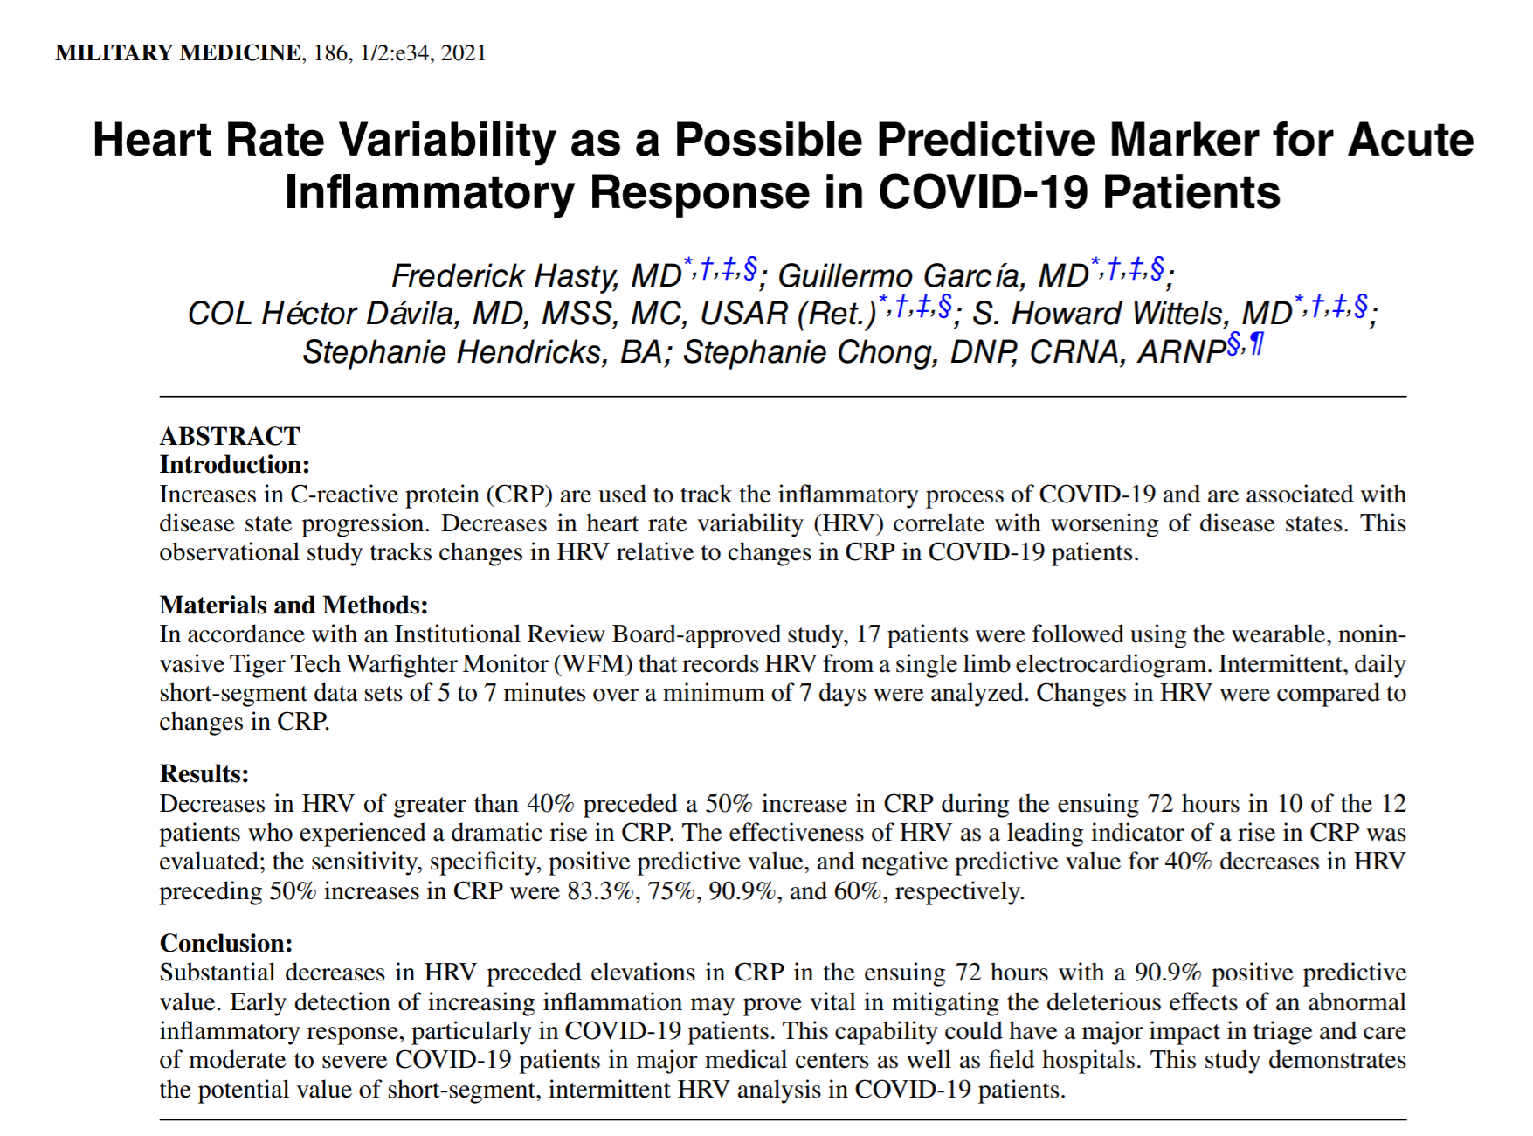
Applications: ECG

Slide 19
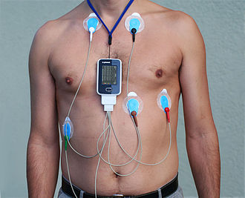
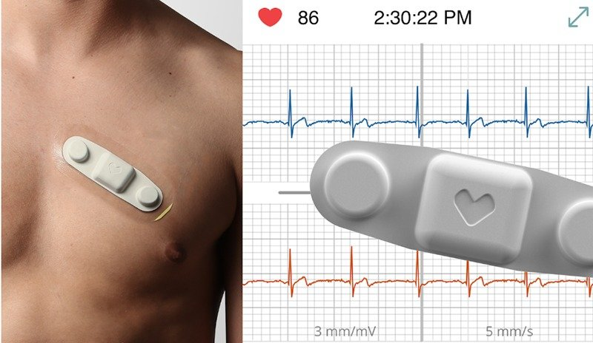
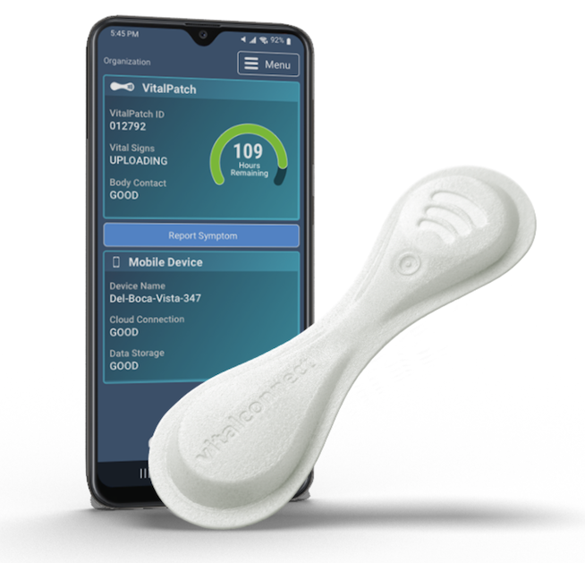
Portable systems: ECG

Slide 20
Any other ways to get HR/HRV

Slide 21
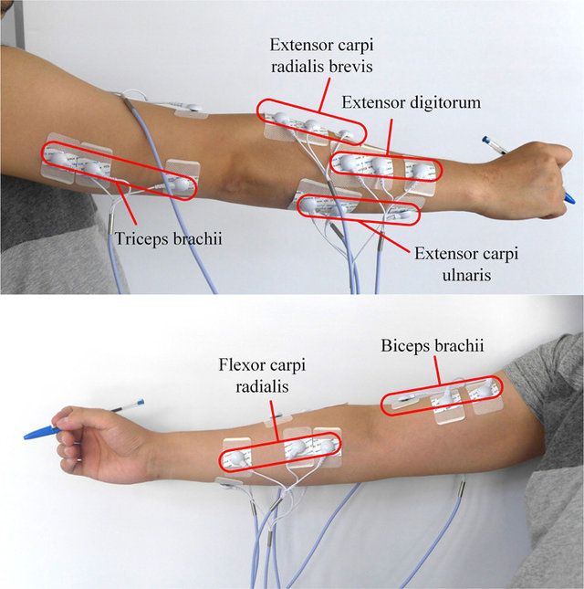

Slide 22
Applications: EMG
EMG is a diagnostic procedure to assess the health of muscles and the nerve cells that control them (motor neurons). EMG results can reveal nerve dysfunction, muscle dysfunction or problems with nerve-to-muscle signal transmission.

Slide 23
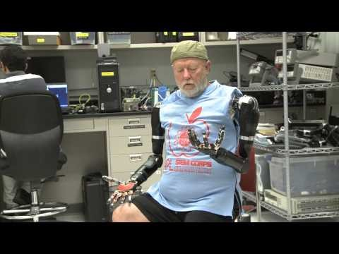
EMG applications
https://www.youtube.com/watch?v=u49aR1D8M40
https://www.youtube.com/watch?v=gHsZ0bwxMsg

Slide 24
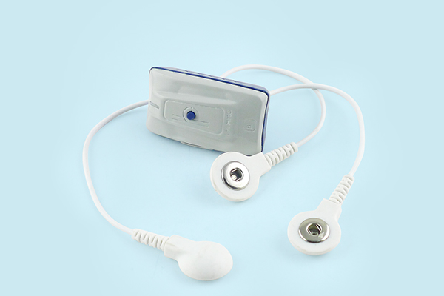
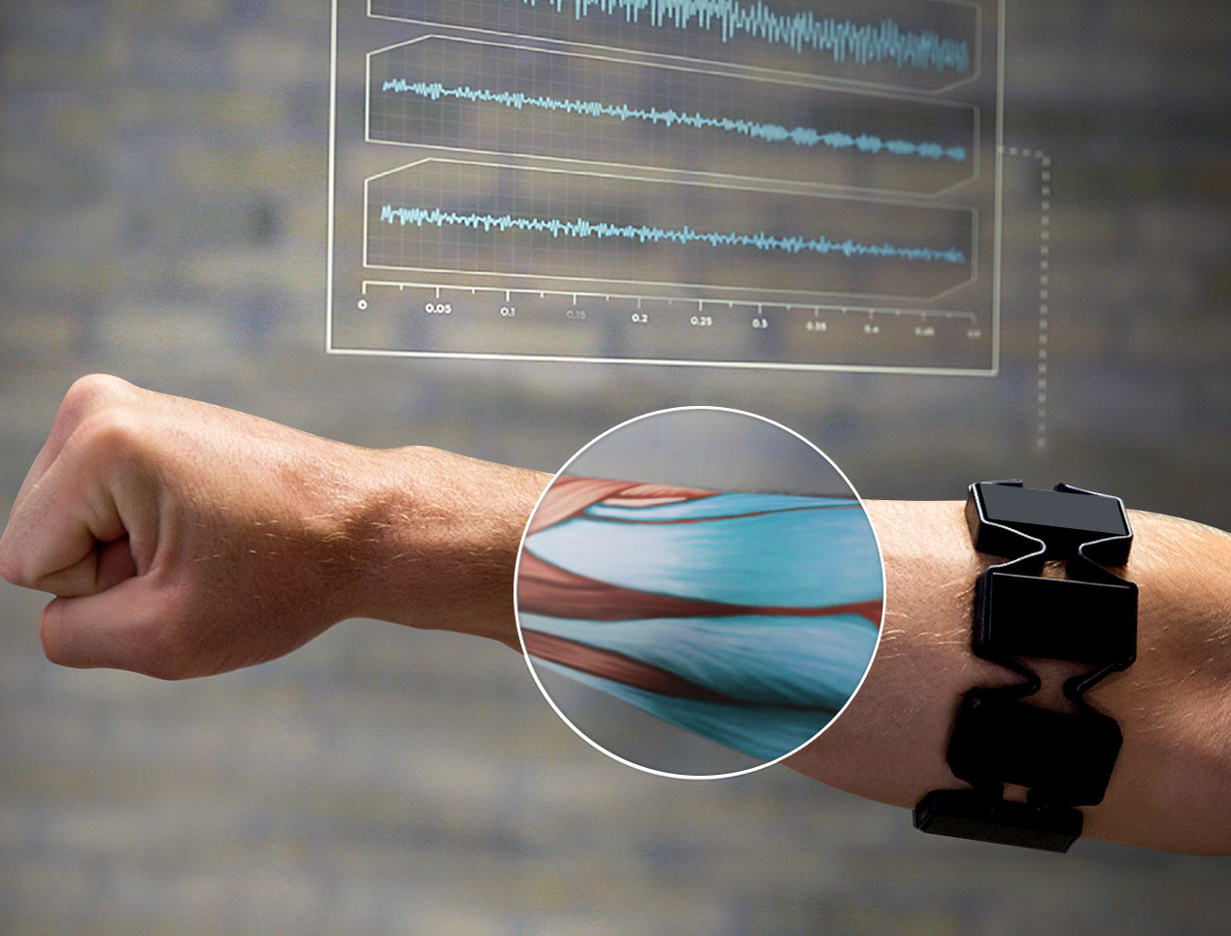
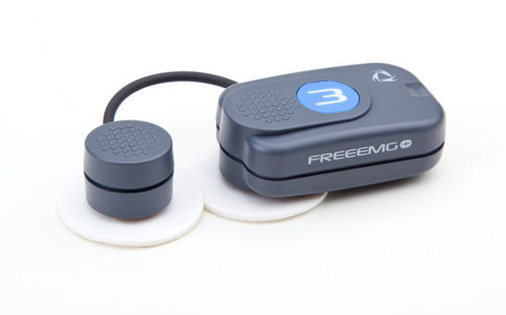
Portable system: EMG

Slide 25
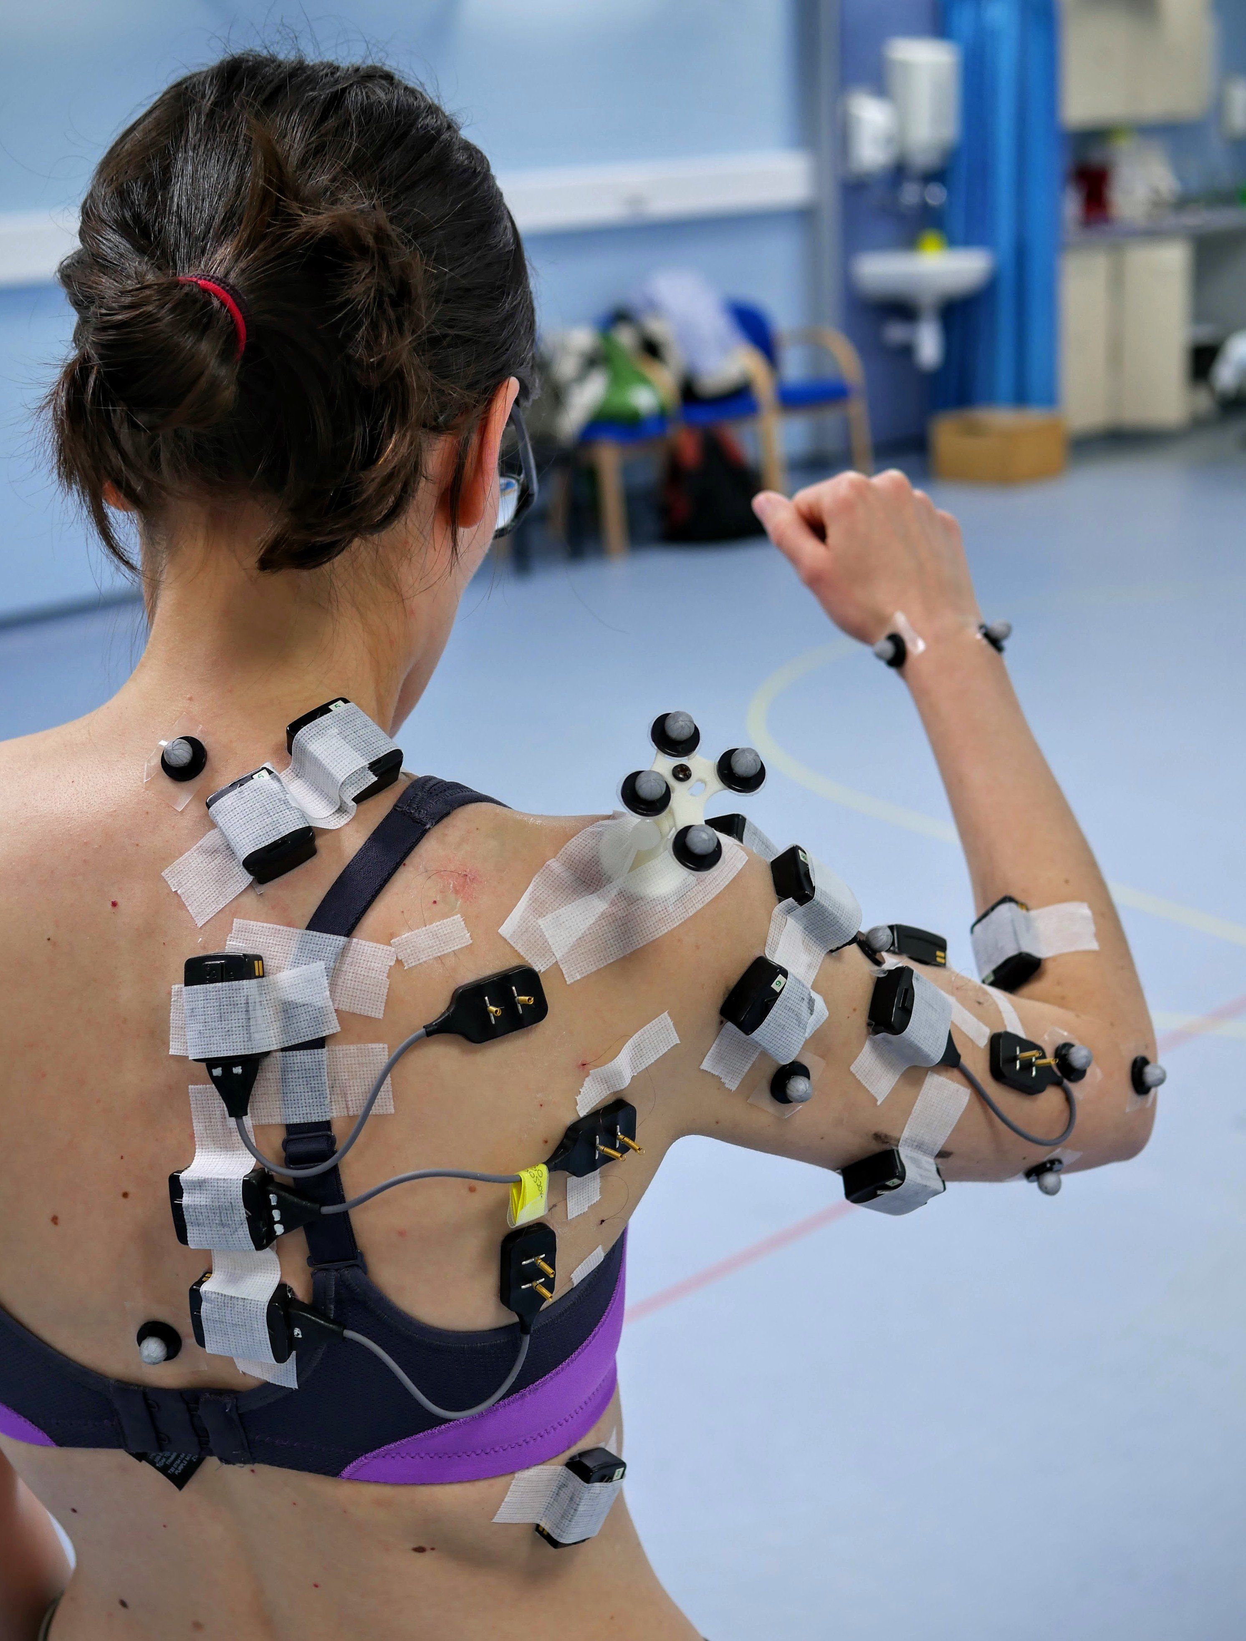
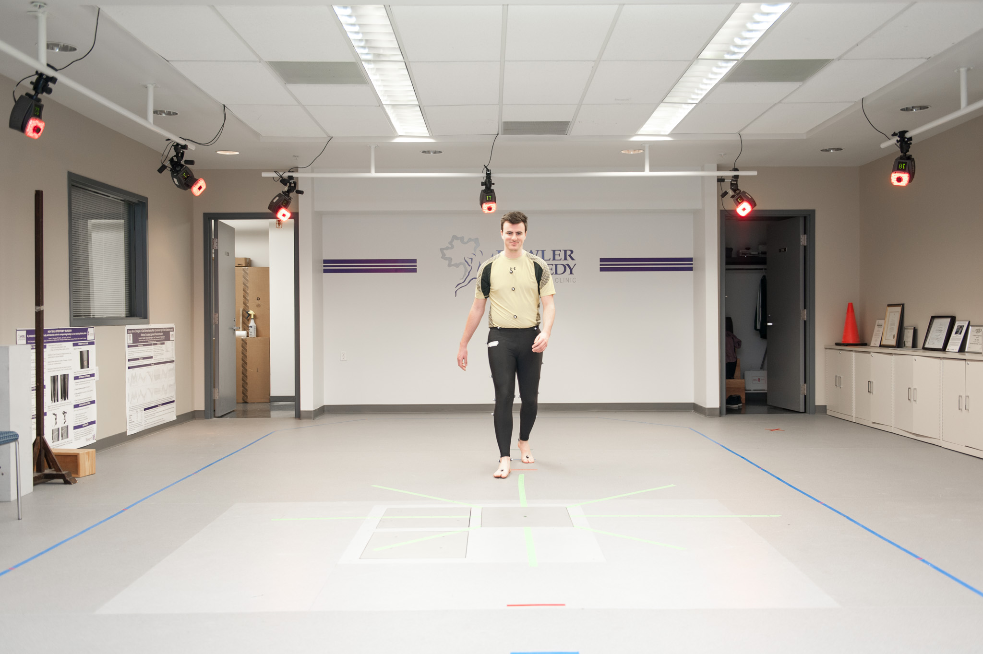
Detailed biomechanics

Slide 26
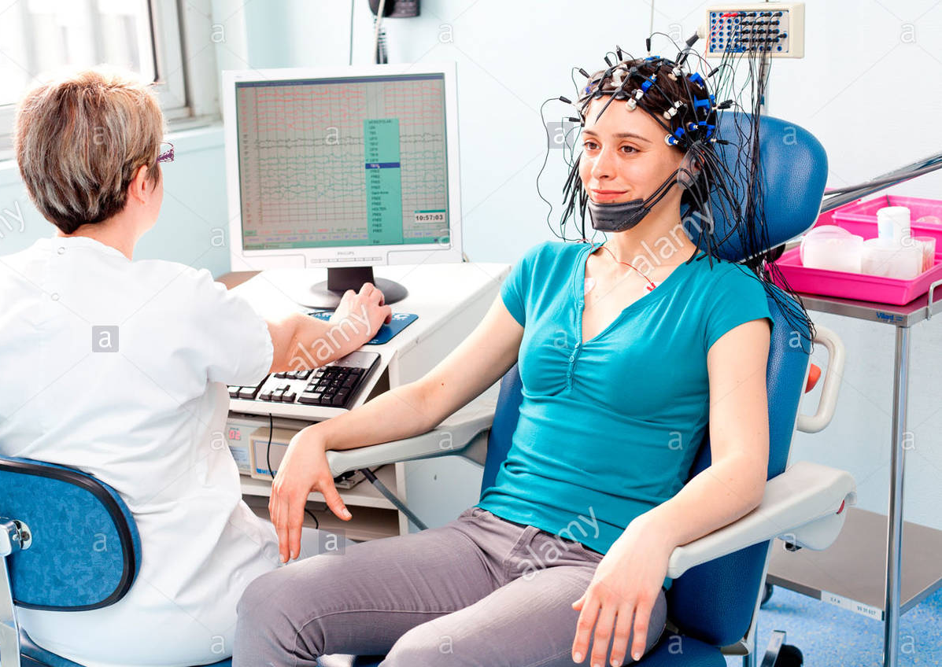

Slide 27
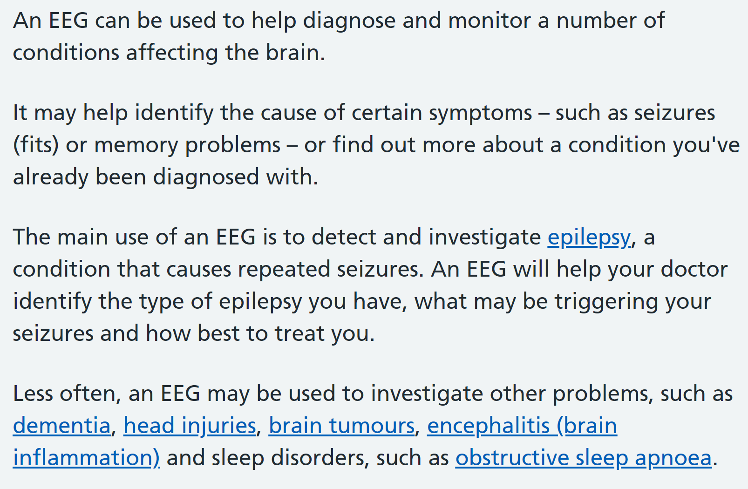
EEG application
https://www.nhs.uk/conditions/electroencephalogram/

Slide 28
Mind control wheelchair https://www.youtube.com/watch?v=1VPY1d2t_FE
SSVEP speller https://www.youtube.com/watch?v=KCW57QDNDos

Slide 29
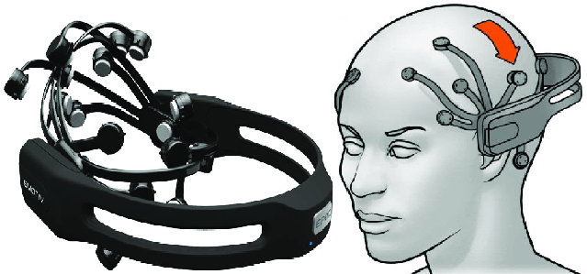
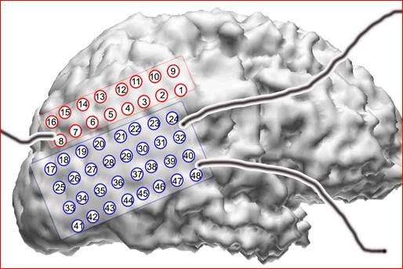
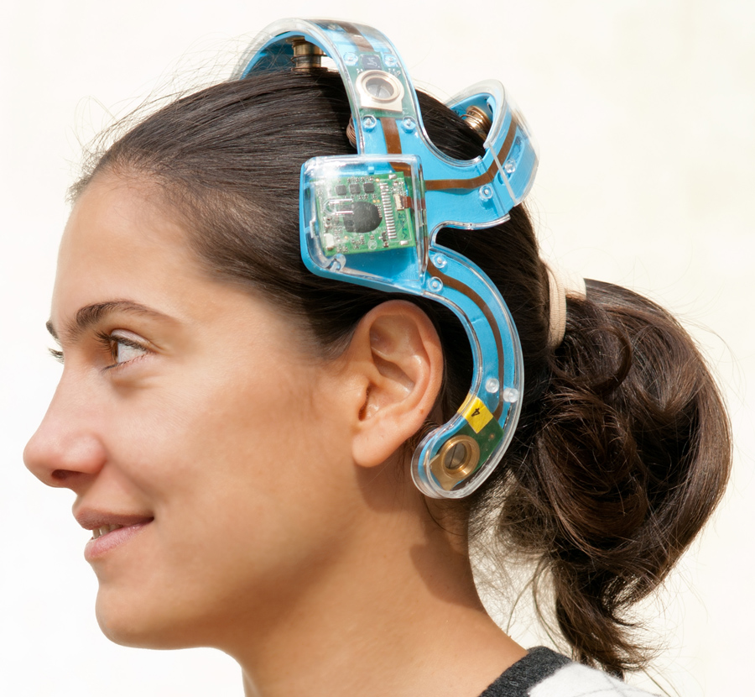
Portable system: EEG

Slide 30
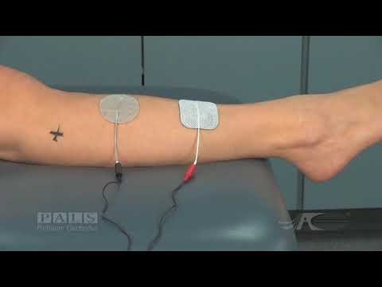
Active intervention: movement
How can we use the muscle electrical signal the other way around
Effect pathway is blocked
Muscle can’t contract by itself
https://www.youtube.com/watch?v=v_3NqHcuxjo

Slide 31
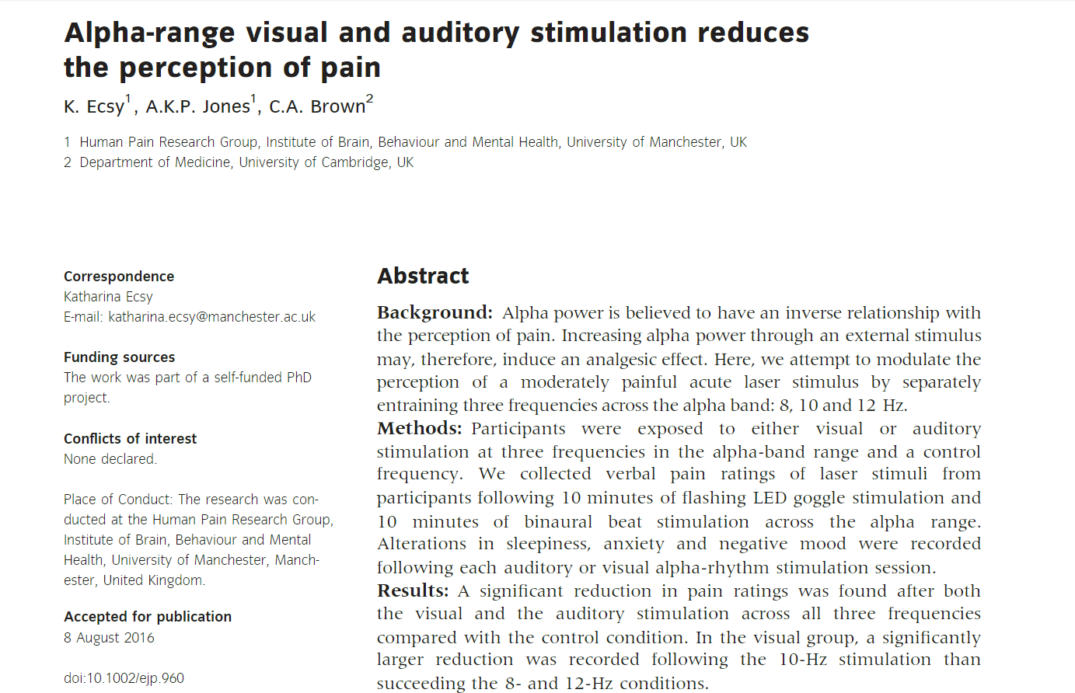
Active intervention: pain management

